Slide 1
Optiver – 07
Meeting minutes &
Action point slides
Date: 18/05/2025 (Week 11)
Present: Ayush Singh, Kylie Haryono, Christy Lee, Tobit Louis, Zichun Han.

Slide 2
Final Code
Complete Formal Code till Feature Engineering and Scaling.
Saved the final data in a separate Parquet.
Ran Random Forest, WLS, HAV-RV on Full Data.
Fixing scalability issues with LSTM.
Tried Running Transformer on Full Data – 300 hrs Training Time.
Tried Running LSTM on Full Data – Originally 220 hrs Training Time, testing updated code that allows model to learn sequentially.

Slide 3
Transformer Model – Our Best Model
Transformer Model – 21 Layers, 101,569 Trainable Parameters.
1 Epoch takes 150 hrs to train on a M3Pro Chip with 18GB RAM.
QLIKE: 0.07 and R²: 0.7 (approx.)
Compared to other Models: WLS (QLIKE: 0.23 and R²: 0.17), HAV-RV (QLIKE: 1183), Random Forest (QLIKE: 0.22 and R²: 0.6), and LSTM (QLIKE: 0.08 and R²: 0.59).

Slide 4
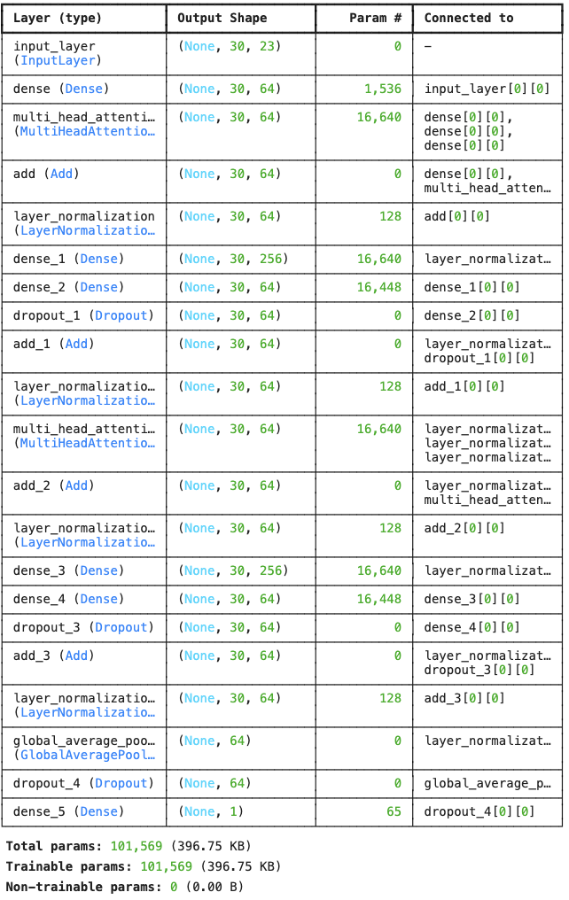
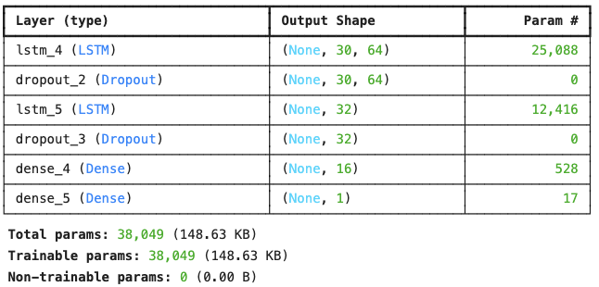

Slide 5
Next Steps– Week 11
Complete Presentation
Work on Report
Try and run Transformer-Based Model.

